Slide 1
Yelp Data analysis
Team 3

Slide 2
Exploratory Data analysis

Slide 3
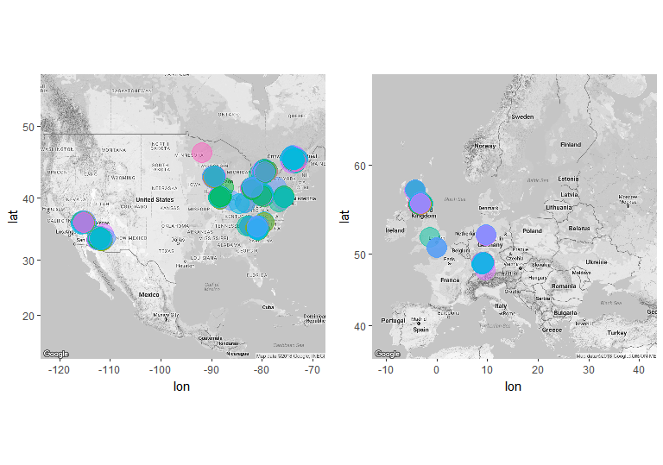
Locations of Restaurants
United States of America
Europe

Slide 4
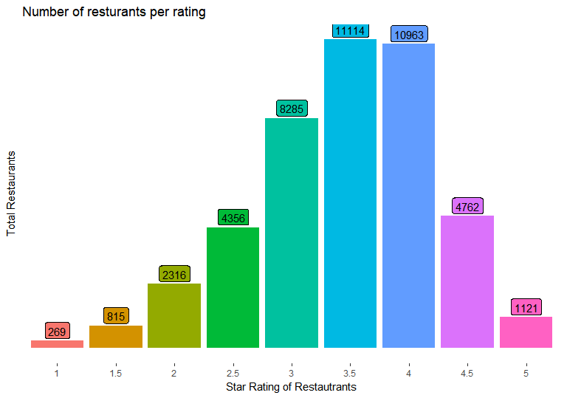
Number of restaurants per rating
3.5 and 4 star rating most common
3 start comes third followed by 2.5 and 4.5 star rating

Slide 5
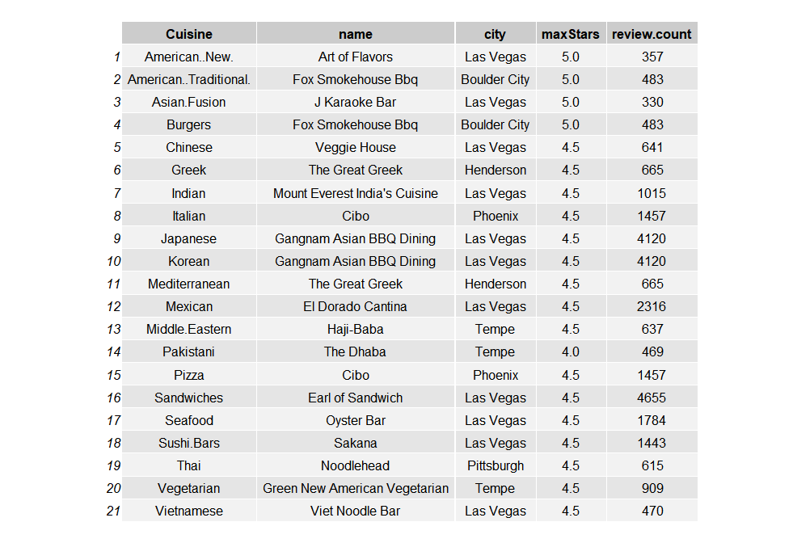
Best Restaurants per Cuisine

Slide 6
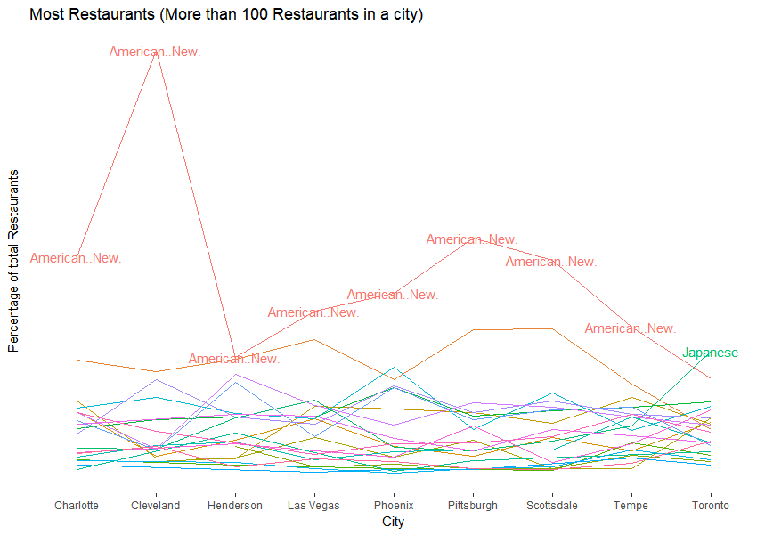
Most Common Cuisine

Slide 7
Text Analysis

Slide 8
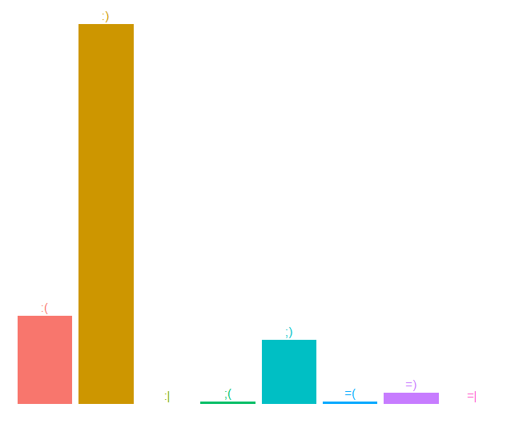
Most common emoticons in reviews

Slide 9
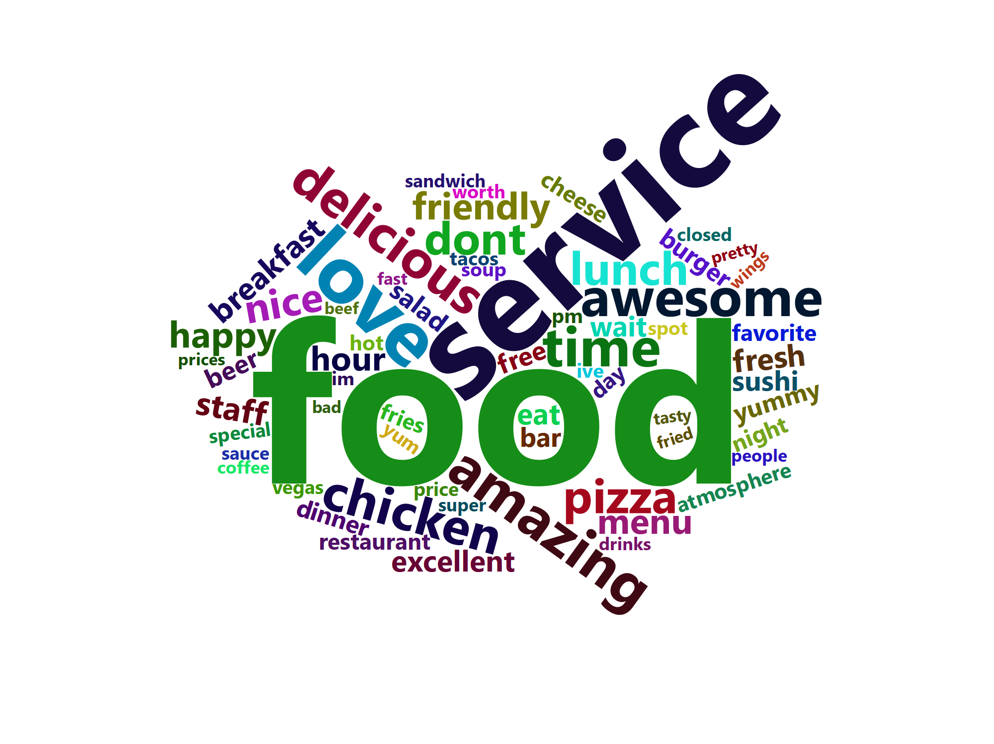
Most common words in reviews

Slide 10
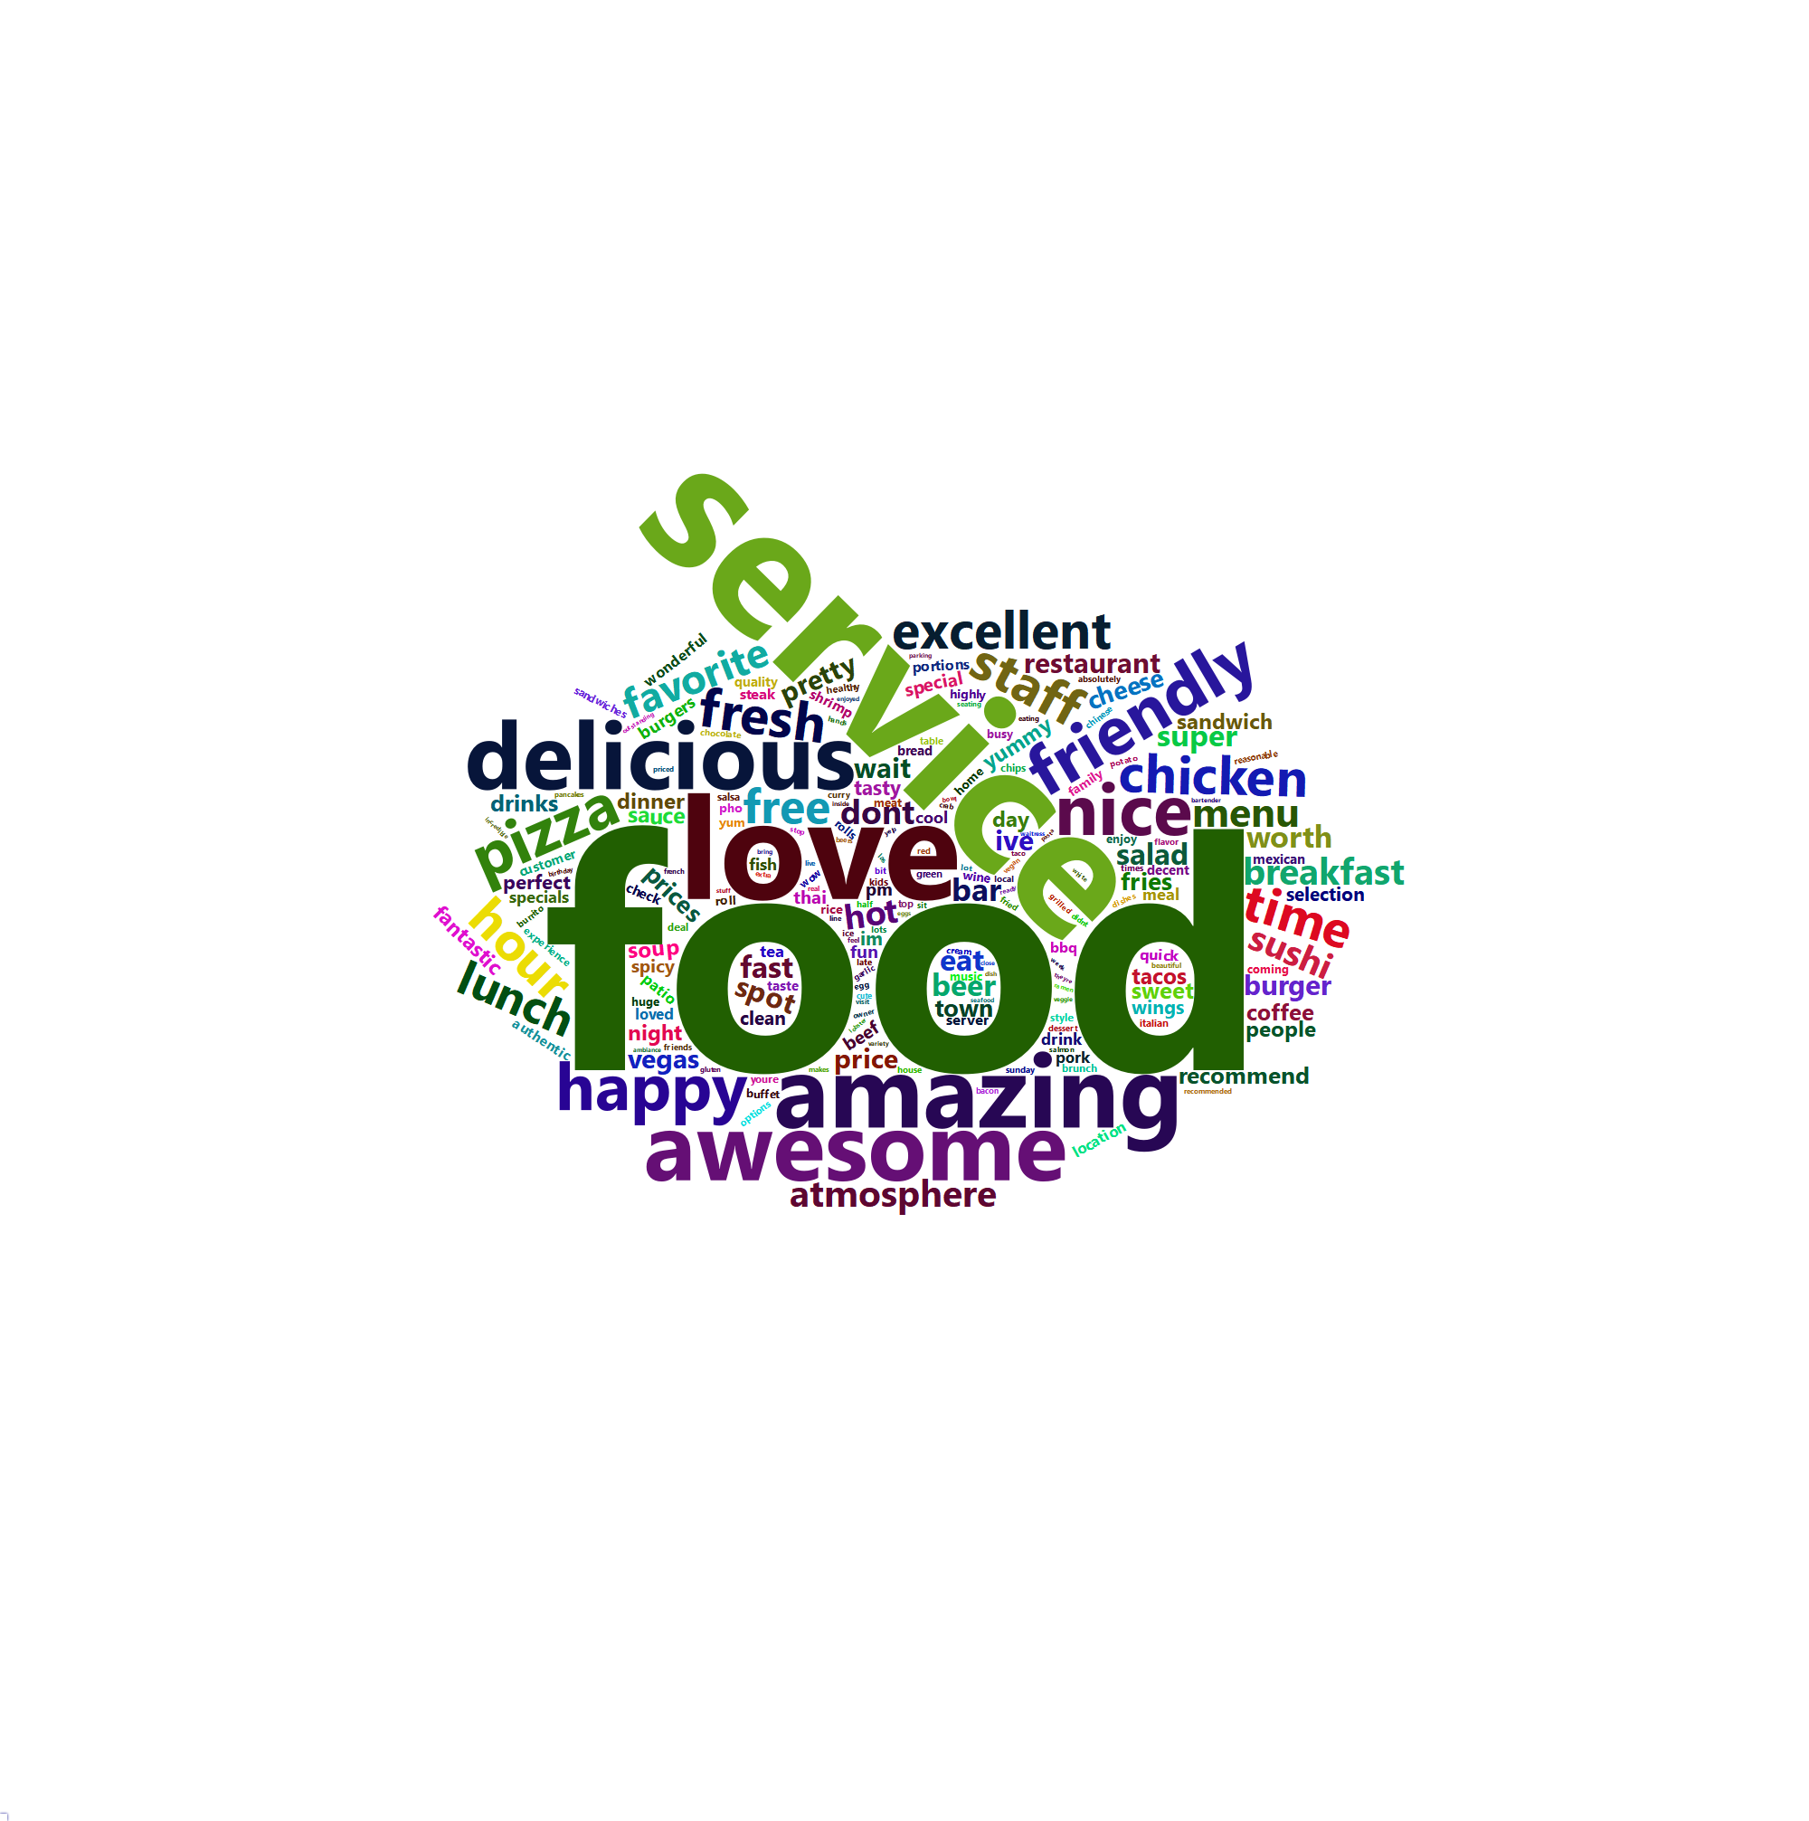
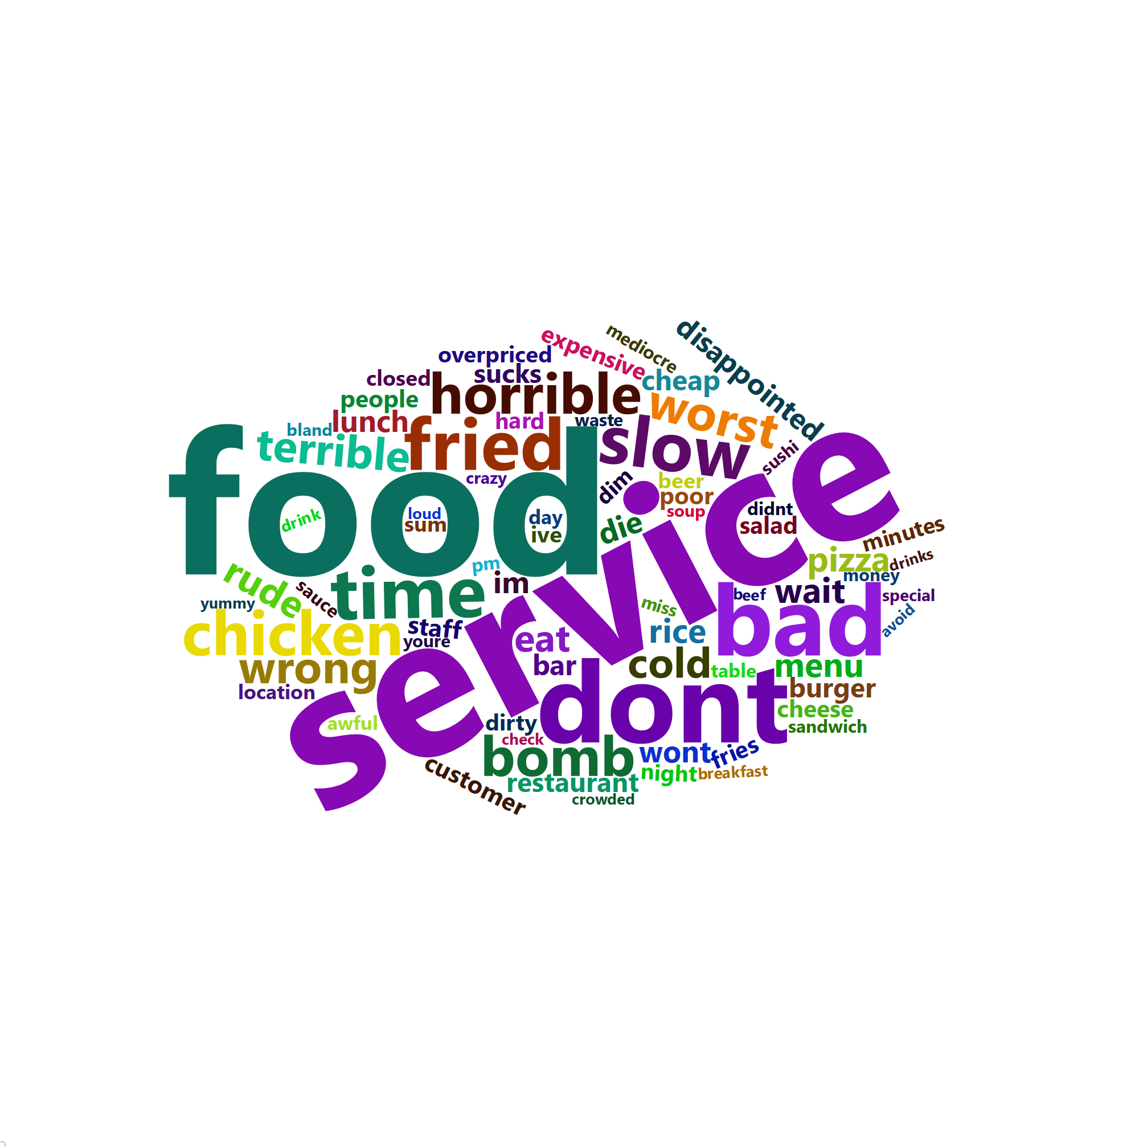
Most common words in reviews contd.

Slide 11
And award for most positive and negative reviews goes to!!!
Most Negative | Most Positive
Its cold and expensive Hipster city I wanna go to Charlies Blah blah blah blah blah blah blah blah blah blah blah blah blah blah blah blah blah blah blah blah blah blah blah blah blah blah | Havent been to Macayos and quite some time however thus far I am pleased Our server is very good Josh is his name and he is highly attentive friendly etc makes the visit here enjoyable Their chips are good Crisp and fresh Salsa was nice and he provided me some house hot sauce to raise the heat a bit I tried the Tomatillo sauce at Joshs suggestion and that was tasty and had a nice kick to it Their guacamole is good as well Dinner is yet to come but I expect will be good
Very good food Blah blah blah blahh blah blah blahh blah blah blahh blah blah blahh blah blah blahh blah blah blahh blah blah blah All the blah blah blah are to extend the review only | Adrian was a wonderfully attentive resourceful and friendly server food came out promptly although the drinks not always so prompt star customer service thank you for all the wonderful appetizer and cocktail recommendations Everything was so flavourful the female servers and female hosts were also very helpful and welcoming Thanks to Tom the manager for the warm reception as well I wish u a speedy recovery on your ACL
I agree with Elizabeth H review Food is disgusting Tried this place three times Food worse each time Everything fried is soggy because preside and left to lay and rot WORST IN PHOENIX Dont try to tell Rude Manager something is bad He doesnt care and is combative Everything worn out from booths uncomfortable chairs silver wear to filthy kitchen and floors Cash only no cards ATM a rip off huge fees Soda is some flat nasty tasting generic Went to Garcias down the street T | Came here with my boyfriend for dinner The food was very good They send out a delicious salsa and bean dip with warm tortilla chips complimentary Margaritas are strong and very good Food is always great as well But the thing that sets this place apart is the service Everyone is so friendly and helpful They are always right on top of things to make sure you have everything you need Especially Hector The nicest server assistant we have seen here Thank you We will be back soon
After watching Kitchen Nightmares I am in complete Shock This bitch Amy needs an ass beating I wish I lived there so I can go to that kitchen and fuck your cuntAss up you stupid crazy psychotic lunatic bitch And simon taking all the tips from his staff How dare you Absolutely disgusting people Ive never seen Gordon Ramsey walk out on a restaurant in all his shows This place is so screwed up because of the owners and psycho chef Amy Youre are a gross excuse for a human being | Simply amazing chicken is delicious fried baked or grilled all very different and taste amazing Baked mac cheese wow good cooked to order fresh and hot make their own sauces and I must say another star I dont like honey mustard I would come back here just for it lol but true it Staff is super friendly welcoming and environment is welcoming and very clean Pricing is very affordable I would pay double food is so good Thank you staff and management my family and I very much enjoyed dinner
very rude staff very rude staff very rude staff very rude staff very rude staff very rude staff very rude staff very rude staff very rude staff very rude staff very rude staff | Best place to celebrate any event We had our baby Jades christening grp party pax and everyone love it Our guests enjoyed the mouthwatering crab legs They all love the free beer wine Our view of the strip just made everything so perfect Thanks to our waiter Manny he was so nice polite The courteous helpful shift Mgrs Ms Julia Mr Aaron Keep up the good job Well surely keep coming back
I cant believe I used to eat at this place We just ordered and everything chicken was actual FAT and dark meat pieces of slimy I dont know what I threw this shit in the garbage becomes I was scared someone could get sick from the slime NO BUENO Stop being so cheap with your ingredients this is how you lose customers greedy ass | DECOR Pleasant comfy Fun to sit the counter to watch chefs work LUNCH Ebi tan udon The broth could be better Miso carbonara udon Almost like Macaroni Cheese with bacon Tempura shrimps ea Tempura soft eggs ea Octopus balls SERVICE Friendly RESTROOM Comfy well maintained Muragame is larger has better decor than Monta Ramen BUT we like Monta Ramens BROTH much better Jan
Identify unigrams
Calculate number of positive and negative words using “bing” lexicons
Take difference of Positive and negative number of words per review and call it a sentiment score.
Identify positive and negative reviews based on sentiment score

Slide 12
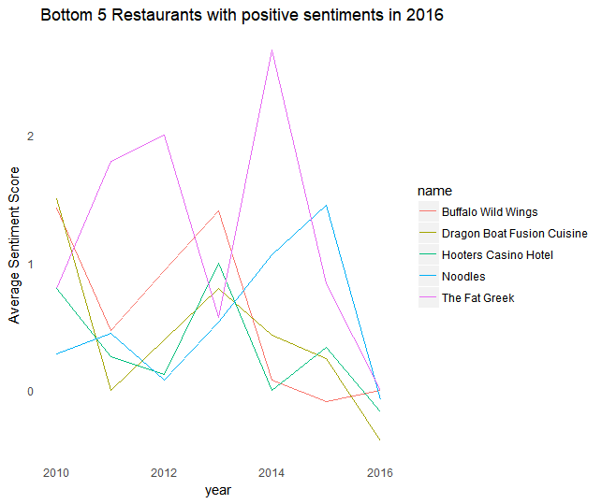
Most and least positively reviewed restaurants

Slide 13
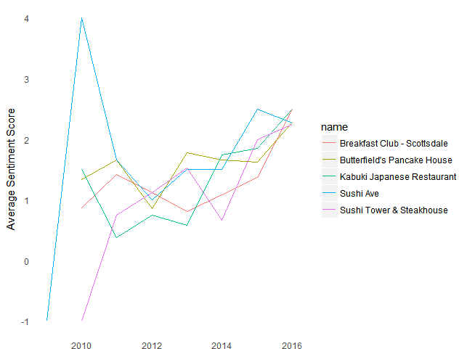
Most and least positively reviewed restaurants

Slide 14
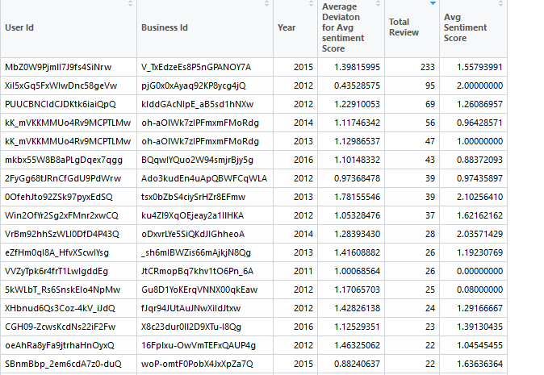
Identify Probable spammers
Calculate average review sentiments for a restaurants
Calculate average review sentiment of a user for a restaurant
Identify user with significantly different sentiment score.

Slide 15
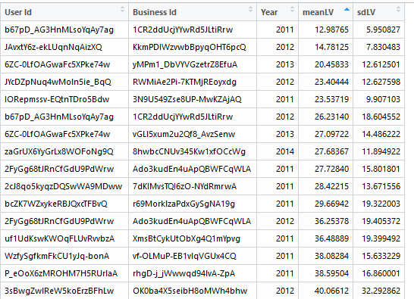
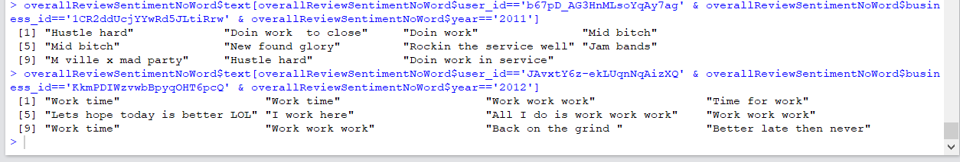
Identify Probable spammers contd.
For each identified user, calculate the average distance and standard deviation between all the reviews

Slide 16
SNEAK-PEAK INTO YOUR FUTURE ON YELP

Slide 17


Business Objective:
A restaurant owner who is currently not on Yelp, want to know what his restaurant rating will be on Yelp.
Goal:
Predict the star rating of a restaurant based on the type of restaurant, and
the price range of the restaurant relative
to the GDP of the area
Star Ratings (Response Variable):
Numeric variable between 1 to 5
Restaurant Characteristics:
Restaurant Category
Restaurant Price Range
Location Characteristics:
State
GDP per capita (quantile)
Population census (quantile)

Slide 18
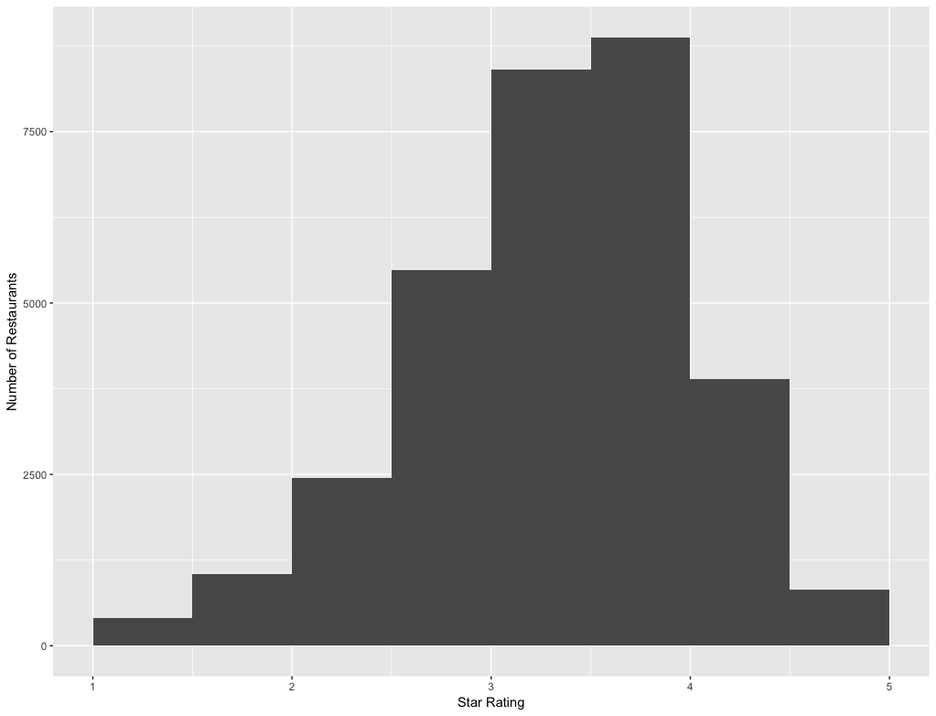
Distribution of Star Ratings
Mean of star ratings: 3.56

Slide 19
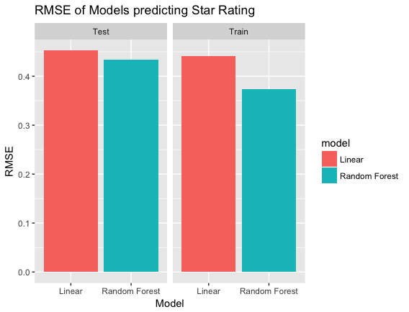
Experimented with Linear and Random Forest Models
Separated data into training and test datasets
80% training, 20% test
Cross Validated models using 5 fold cross validation
Model Results:

Slide 20
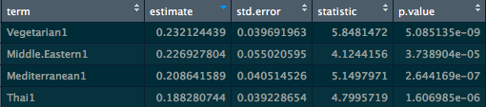
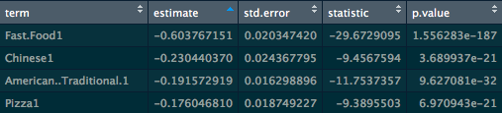

Factors that affect Star Ratings in Las Vegas
Being open on Sunday
Fast Food category
Having a drive through

Slide 21
Business Objective:
A restaurant owner who is currently not on Yelp, want to know what his restaurant rating will be on Yelp.
Goal:
Predict Higher vs Lower Star Ratings based on Restaurant characteristics
Star Ratings (Response Variable):
High Star Rating: 4 and above
Low Star Rating: 3.5 and below
Restaurant Characteristics:
Restaurant Category
Restaurant Amenities
Restaurant open hours and timings

Slide 22
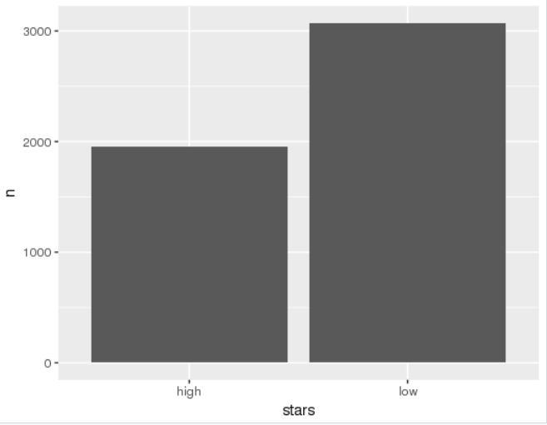
Star Ratings (Response Variable):
High Star Rating: 4 and above
Low Star Rating: 3.5 and below
Restaurant Characteristics: (Explanatory variables)
Restaurant Category
Restaurant Amenities
Restaurant open hours and timings

Slide 23
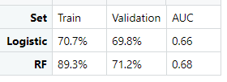
Experimented with Logistic and Random Forest Models
Removed Zero Variance and insignificant variables
Cross Validated models using 5 fold cross validation
Model Results:

Slide 24
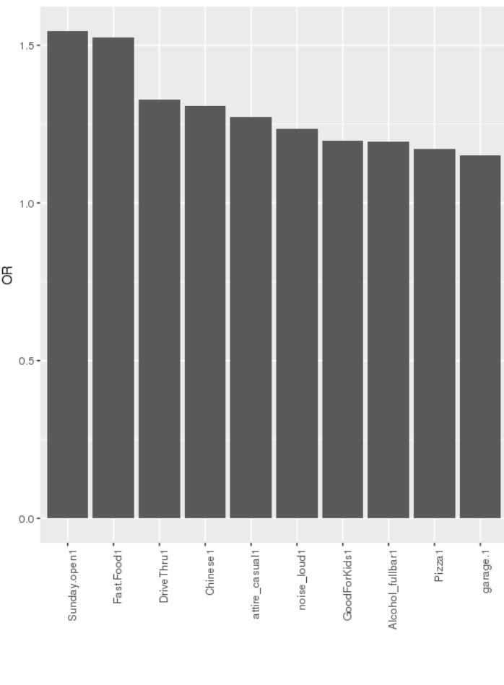
Factors that affect Star Ratings in Las Vegas
Being open on Sunday
Fast Food category
Having a drive through

